Slide 1
Lesson objective
Title: Outliers
Aim – be able to:
State the impact an outlier has on the mean, compared to the median.
Plan:
Review statistical language
Review calculating mean median mode from a frequency table
Investigate how outliers impact the mean

Slide 2
Review: identifying, collecting, graphing and analysing numerical and categorical data.
Numerical data refers to the data that is in the form of numbers, and not in any language or descriptive form.
Categorical data refers to a data type that can be stored and identified based on the names or labels given to them.
When collecting data results should be stored I a table.
A frequency table is a method of organizing raw data in a compact form by displaying categories, or a series of scores in ascending or descending order, together with their frequencies—the number of times each category or score occurs in the respective data set. A frequency table commonly utilises a tally.
Survey: the process of gathering data on a target population
Target population: the group you are studying
Census: the process of surveying the entire target population.
Sample: the process of surveying a part of the target population, in an attempt to estimate the target population.
The 3 methods of random sampling are simple random sampling, systematic sampling, self-selecting sampling (volunteer).
Each of the 3 methods of sampling can be stratified, meaning sub-groups are sampled proportionally.
Due to sampling only being able to provide an estimate biasing may occur.
Biasing is defined as a systematic deviation from the actual value.
Deviation: the action of departing from an established course or accepted standard.

Slide 3
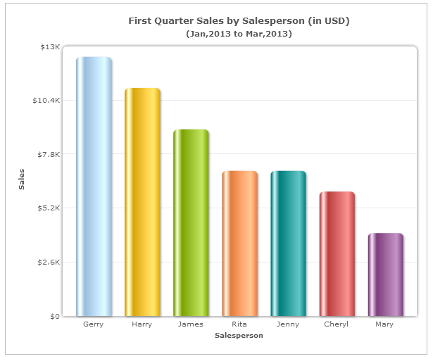
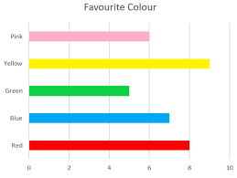
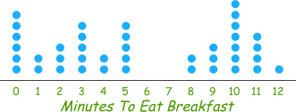
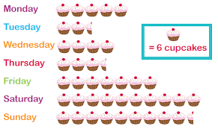
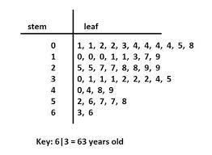
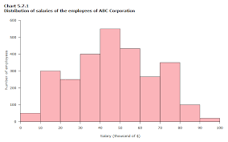
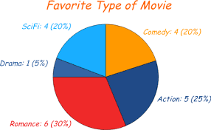
A column graph displays the frequency of the data with length of vertical bars.
A bar chart displays the frequency of the data with length of horizontal bars.
Numerical data can be displayed in column graphs, bar charts, histograms, stem and leaf plots.
Categorical data can be displayed column graphs, bar charts, dot plots, pictograms and pie graph.
Dot plot
Column Graph
Bar Chart
Pictogram
Stem and leaf plot
Histogram
Pie graph

Slide 4
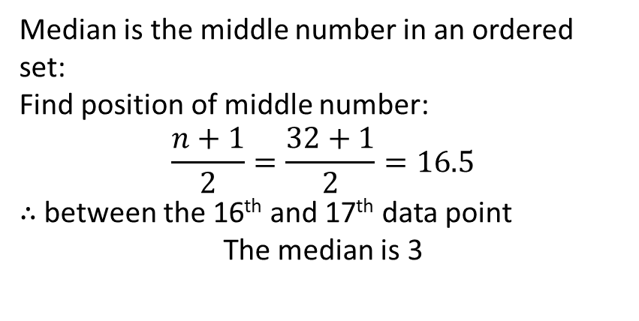
Calculating mean median mode from a frequency table:
Score | Frequency
1 | 4
2 | 8
3 | 6
4 | 3
5 | 11
Total | 32
Mean:
13th, 14th, 15th,16th , 17th
Median:
Mode:
Median is the middle number in an ordered set:
Find position of middle number:
$$\frac{n+1}{2}=\frac{32+1}{2}=16.5$$
$∴$ between the 16th and 17th data point
The median is 3
Mode is the most frequent:
5 is the most frequent with a frequency of 11

Slide 5
Calculating mean median mode from a frequency table:
Score | Frequency | Product
1 | 4
2 | 8
3 | 6
4 | 3
5 | 11
Total | 32
Mean:
Median:
Mode:
Median is the middle number in an ordered set:
Find position of middle number:
$$\frac{n+1}{2}=\frac{32+1}{2}=16.5$$
$∴$ between the 16th and 17th data point
The median is 3
Mode is the most frequent:
5 is the most frequent with a frequency of 11

Slide 6

Calculating mean median mode from a frequency table:
Score | Frequency | Product
1 | 4 | 4
2 | 8 | 16
3 | 6 | 18
4 | 3 | 12
5 | 11 | 55
Total | 32 | 105
Mean:
$$\overline{x}=\frac{105}{32}$$
$$=3.28 (2dp)$$
Median:
Mode:
Median is the middle number in an ordered set:
Find position of middle number:
$$\frac{n+1}{2}=\frac{32+1}{2}=16.5$$
$∴$ between the 16th and 17th data point
The median is 3
Mode is the most frequent:
5 is the most frequent with a frequency of 11

Slide 7
Outlier: is a data point that lies outside the overall pattern in a distribution.
Pick the outlier from the set:
Set 1: 1, 2, 3, 1, 2, 3, 8, 1, 2, 3, 1, 2, 3
Set 2: 10, 11, 14, 15, 16, 10, 15, 11, 14, 13, 1, 12, 13, 14
Set 3: 4, 31, 32, 34, 38, 45, 56, 48, 52, 29, 101, 41, 37, 35

Slide 8
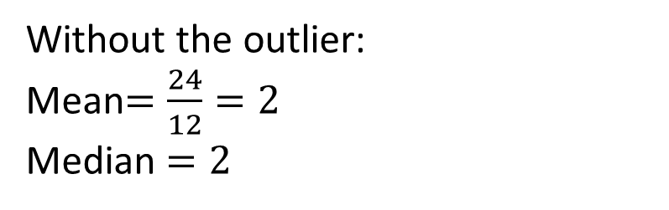
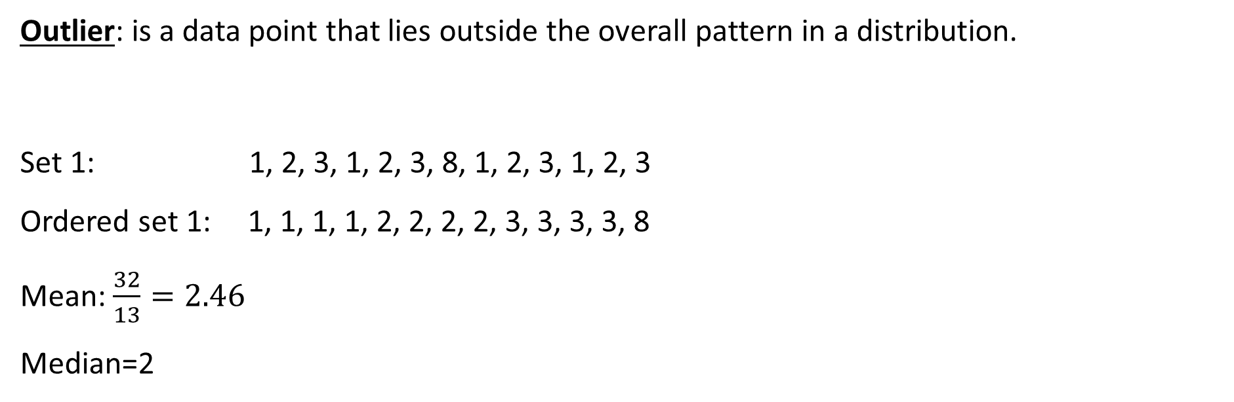
Outlier: is a data point that lies outside the overall pattern in a distribution.
Set 1: 1, 2, 3, 1, 2, 3, 8, 1, 2, 3, 1, 2, 3
Ordered set 1: 1, 1, 1, 1, 2, 2, 2, 2, 3, 3, 3, 3, 8
Mean: $\frac{32}{13}=2.46$
Median=2
Without the outlier:
Mean$=\frac{24}{12}=2$
Median $=2$
Which average is effected more by the outlier?
The Mean
What does the outlier do to the mean compared to the median?
It increases it, skewing it positively

Slide 9
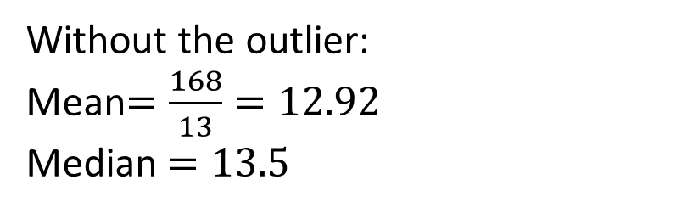
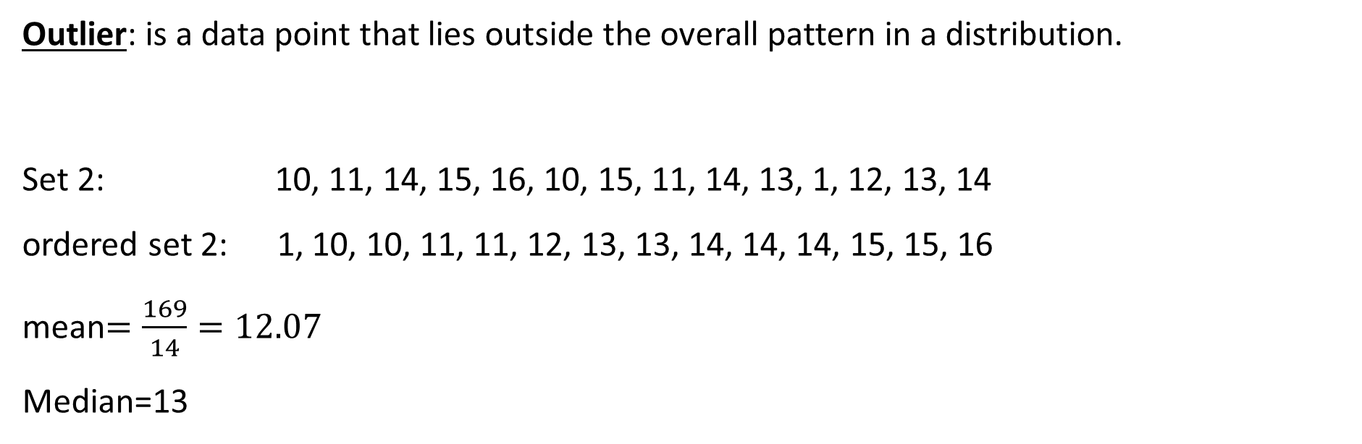
Outlier: is a data point that lies outside the overall pattern in a distribution.
Set 2: 10, 11, 14, 15, 16, 10, 15, 11, 14, 13, 1, 12, 13, 14
ordered set 2: 1, 10, 10, 11, 11, 12, 13, 13, 14, 14, 14, 15, 15, 16
mean$=\frac{169}{14}=12.07$
Median=13
Without the outlier:
Mean$=\frac{168}{13}=12.92$
Median $=13.5$
Which average is effected more by the outlier?
The Mean
What does the outlier do to the mean compared to the median?
It decreases it, skewing it negatively

Slide 10
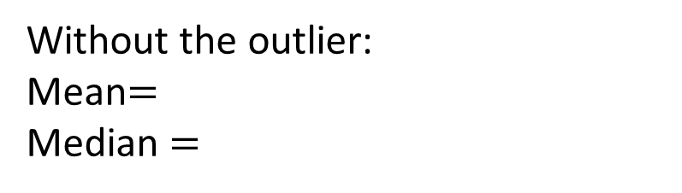
Outlier: is a data point that lies outside the overall pattern in a distribution.
Set 3: 4, 31, 32, 34, 38, 45, 56, 48, 52, 29, 101, 41, 37, 35
Ordered set 3: 4, 29, 31, 32, 34, 35, 37, 38, 41, 45, 48, 52, 56, 101
Mean:
Median:
Without the outlier:
Mean$=$
Median $=$
Which average is effected more by the outlier?
What does the outlier do to the mean compared to the median?

Slide 11
Choral response
An outlier will skew the mean positively or negatively, depending on its value in relation to the data set.
If the outlier is smaller than the data set: negative skew
If the outlier is larger than the data set: positive skew

Slide 12
Data set
Identify the outlier
What will it affect?
Positive or negative skew?
1, 2, 1, 3, 5, 3, 6, 7, 1, 7, 8, 9, 45, 1, 3
1, 2, 1, 3, 0.5, 3, 6, 7, 1, 7, 8, 9, 4,5, 1, 3

Slide 13
Complete HAESE
Page 393 – 398

